Slide 1
Do Now!
As you quietly unpack, consider the answers to the following questions:
What is Hardy saying about the position of women?
Why isn’t it possible to have the advantages of both a maid and prostitute during the Victorian Era?
Is it possible to be virtuous and also have luxuries in today’s society? Why or why not?
Do other countries across the world have similar attitudes to the position of women? Which countries have this attitude and why is it that way?
Notes:
Students should think about this quietly as they come in. (4mins)

Slide 2
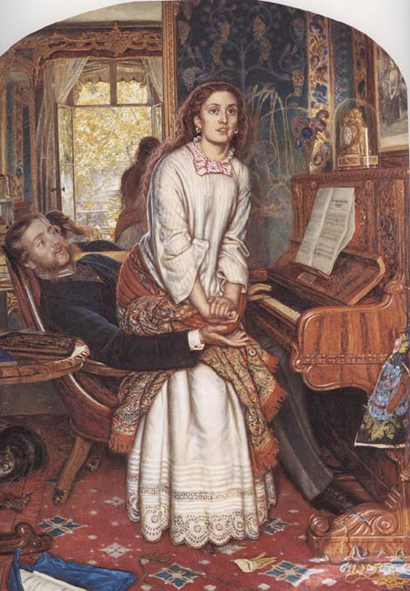
Learning objectives:
AO1: respond to texts critically and imaginatively, select and evaluate textual detail to illustrate and support interpretations.
AO2: explain how language, structure
and form contribute to writers’
presentation of ideas, themes and
settings.

Slide 3
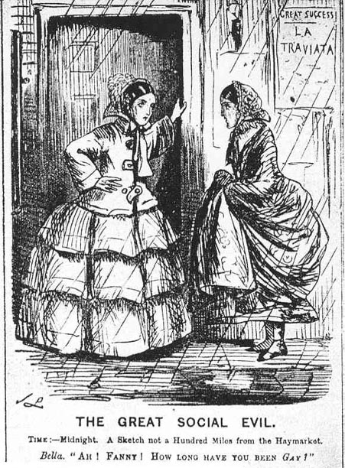
Starter:
THE GREAT SOCIAL EVIL - Examine the content of this cartoon. In groups of three, discuss the questions alongside and any other ideas your group feels are important. Feed back your ideas to your teacher and the rest of the class.
What does this suggest about the way a woman can achieve success?
What are the differences between the prostitute and the maid?
What is the general view of prostitution?
‘Gay’ referred to prostitution

Slide 5
Summary
A young country girl bumps into her friend Melia in the street when she’s in town.
Melia used to be a farm labourer but now she’s a prostitute. She’s dressed in rich clothes and finery. Now that she’s left her old life behind, she speaks with a more refined accent too.
Melia says that her life has changed now that she is ruined. She means morally ruined as a prostitute.
The country girl wishes she could have Melia’s lifestyle but Melia dismisses her as a naive farm girl.
YOU’VE GOT TO KNOW WHAT EACH AND EVERY POEM IS ABOUT! YOU SHOULD BE ABLE TO SUMMARISE EACH POEM INTO A FEW KEY WORDS.

Slide 6
‘Melia is short for Amelia; what does this suggest about the women’s relationship?
What is ambiguous about the word ‘ruined’?
Ambiguous – could mean that she’s poor, but also suggests moral ruin.
Shortened name (Amelia) suggest they are close friends.
The Ruined Maid
"O 'Melia, my dear, this does everything crown! Who could have supposed I should meet you in Town? And whence such fair garments, such prosperi-ty?" "O didn't you know I'd been ruined?" said she.
Look at the last line of each verse, who always has the last word? Does ‘Melia seem to enjoy her status as a ruined woman?
Melia always has the last word in the conversation – seems proud to be ruind.
Thomas Hardy (1840 – 1928) was born in Dorset. He trained as an architect before becoming a well-known novelist. He wrote classic and often controversial books like ‘Jude the Obscure’ and ‘Far from the Maddening Crowd’, as well as writing poetry.

Slide 7
How does ‘Melia’s old life compare with her current life?
Contrast – the material signs of poverty with new clothes and wealth.
What was ‘Melia’s former life defined by?
Former life defined by hard work.
"You left us in tatters, without shoes or socks, Tired of digging potatoes, and spudding up docks; And now you've gay bracelets and bright feathers three!" "Yes: that's how we dress when we're ruined," said she. -"At home in the barton you said 'thee' and 'thou,' And 'thik oon,' and 'theäs oon,' and 't'other'; but now Your talking quite fits 'ee for high compa-ny!" "Some polish is gained with one's ruin," said she.
Repetition gives the poem a song-like, light-hearted quality.
What effect does the repetition of ‘she said create?
How has ‘Melia’s rural accent been written? How does it contrast with her new form of speech?
Rural accent written phonetically - contrasts with the more eloquent language of high society.

Slide 8
Consider use of imagery, what did ‘Melia use to look like?
Image compares her to an animal.
"Your hands were like paws then, your face blue and bleak But now I'm bewitched by your delicate cheek, And your little gloves fit as on any la-dy!" "We never do work when we're ruined," said she. "You used to call home-life a hag-ridden dream, And you'd sigh, and you'd sock; but at present you seem To know not of megrims or melancho-ly!" "True. One's pretty lively when ruined," said she.
Consider use of the word ‘bewitched’, what does it suggest about ‘Melia’s former appearance?
She used to look barely human. Now she’s beautiful but it seems like a spell or illusion.
This nightmarish image contrasts with the illusion of Melia’s glamorous new life.
How does ‘Melia’s new life compare with this nightmarish image?
What does this line suggest to you about ‘Melia’s attitude towards her new life?
Again, Melia appears proud of her ruined condition and immoral new life.

Slide 9
How would you describe the country girl’s feelings towards ‘Melia’s new clothes?
Country girl is envious of Melia’s outward appearance and riches.
What does the word ‘strut’ suggest?
Suggests Melia’s new confidence in society.
"I wish I had feathers, a fine sweeping gown, And a delicate face, and could strut about Town!" "My dear a raw country girl, such as you be, Cannot quite expect that. You ain't ruined," said she.
Irony – language reminds us of where she’s come from.
What adjective could you use to describe ‘Melia’s tone? How does she appear to be acting?
Patronising – Melia acts as if she is better than the country girl.
What is ‘Melia suggesting the country girl doesn’t quite understand?
Melia says the country girl doesn’t quite understand the cost of moral ruin.
Why could the use of the pronoun ‘you’ be considered ambiguous?
Ambiguous – country girl isn’t morally ruined but could be in poverty.
What is ironic about ‘Melia’s use of the word ‘ain’t’?

Slide 10
What type of poem is this?
This poem is a form dramatic dialogue. In the poem, Hardy presents a conversation between two women. One of the women is called ‘Melia. She has moved away and has changed in many ways. As they talk, the role and treatment of women during the Victorian era reveals itself as a major theme within the poem. At the time, women were not treated equally to men. They were forced to project an image of morality, and if they deviated away from that image, they were seen as being tainted or soiled.
In ‘The Ruined Maid’, Hardy uses irony and satire.
Irony: This is a device writers use to express something different from and often opposite to their literal meaning.
Satire: Satire aims to show the reader the absurdity of human follies and vices. Writers who use satire want the reader to acknowledge such wrongs in society.

Slide 11
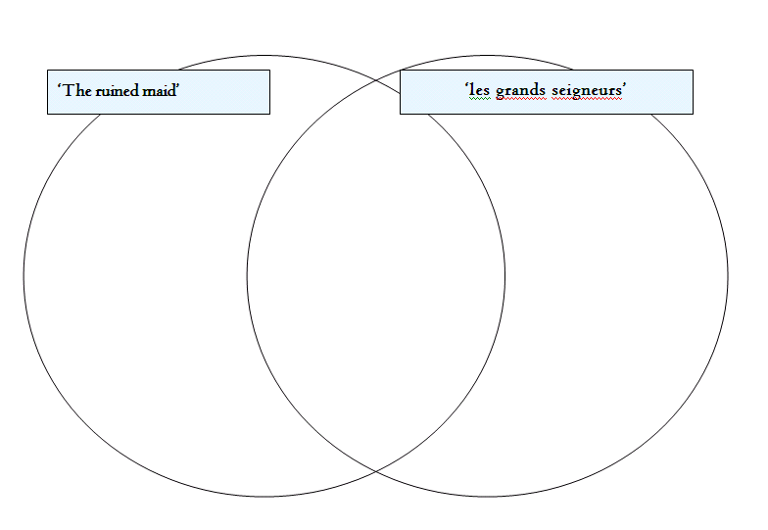
Comparing poems
AO3: Make comparisons and explain links between texts, evaluating writers’ different ways of expressing meaning and achieving effects.
 Use the Venn diagram to find the differences and similarities between the two poems.

Slide 12
Sample exam question
Compare the ways women are represented in ‘The Ruined Maid’ and ‘Les Grand Seigneurs’.

Slide 13
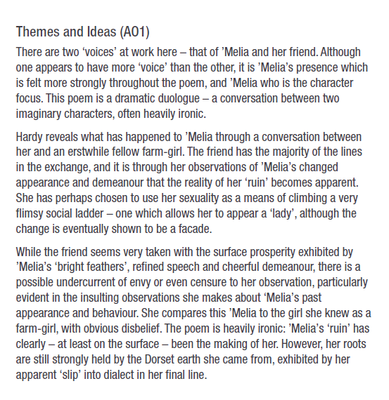

Slide 14
