Slide 1
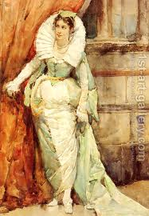
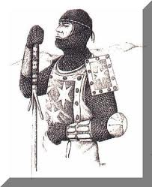
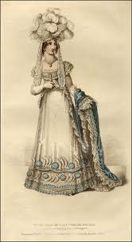
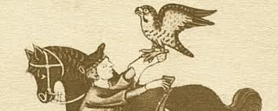
Les Grands Seigneurs
Dorothy Molloy

Slide 2
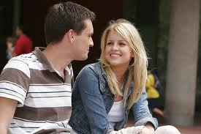
Thrill of the chase
Which is better- a relationship or the thrill of the chase?
Write down bullet point arguments for both sides
Pick a female perspective-does this influence your decision?

Slide 3
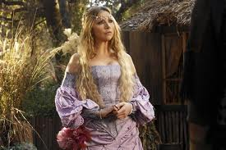
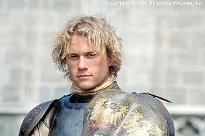
Now roll it back a couple of hundred years
Imagine you are in middle ages attempting to woo a most beautiful lady of the court.
What would you bring her to win her hand?
If she was your wife how would you treat her?

Slide 4
Lesson Objectives
LO1: Analyse “les grand seigneurs” focusing on M.I.T.S.F
LO2: Students will be able to comment on the use of voice and character to express attitude in the poem.

Slide 5
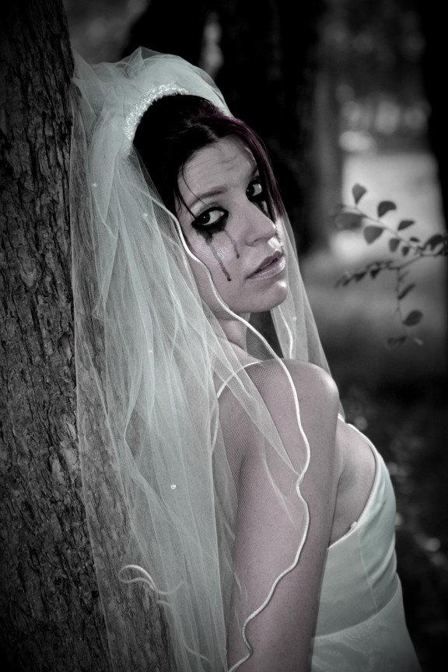
‘Les Grands Seigneurs’ Some context…
‘Les Grands Seigneurs’ was published in Dorothy Molloy’s first and only collection of poems, Hare Soup. Almost all of the poems are written in the first person. Many combine sexual and religious (Catholic) imagery and several deal with abusive relationships. The blurb for Hare Soup talks of a ‘poetry-of-the-absurd that will make your hair stand on end’ and of ‘deftly crafted poems [that] are as unsettling as they are affecting, exploring a world of intimacy from the tensely erotic to something altogether more malevolent’. Some of her poems are comic and shocking, like surrealist paintings. Another characteristic is Molloy’s use of foreign languages, principally French.
‘Seigneur’ means master, or land-owner, or one distinguished by dignity or rank. ‘Un grand seigneur’ is a great lord. However, in the plural it can also mean warlords.

Slide 6
‘Les Grands Seigneurs’ by Dorothy Molloy
Men were my buttresses, my castellated towers,
the bowers where I took my rest. The best and worst
of times were men: the peacocks and the cockatoos,
the nightingales, the strutting pink flamingos.
Men were my dolphins, my performing seals; my sailing-ships,
the ballast in my hold. They were the rocking-horses
prancing down the promenade, the bandstand
where the music played. My hurdy-gurdy monkey-men.
I was their queen. I sat enthroned before them,
out of reach. We played at courtly love:
the troubadour, the damsel and the peach.
But after I was wedded, bedded, I became
(yes, overnight) a toy, a plaything, little woman,
wife, a bit of fluff. My husband clicked
his fingers, called my bluff.

Slide 7
First reading of the poem
Read through the entire poem twice.
What do you immediately notice?

Slide 8
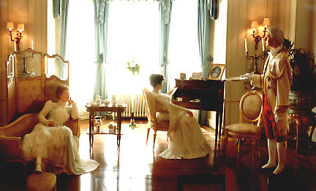
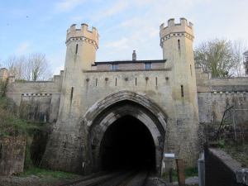
“the bowers where I took my rest”
“castellated towers”
“buttresses”
What kind of images are we presented with in the first three stanzas? What do they tell us about the speaker’s past relationships with men?

Slide 9
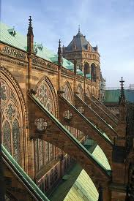
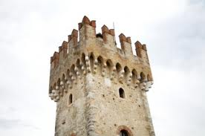
Language
Buttresses- is an architectural structure built against or projecting from a wall which serves to support or reinforce the wall
Castellated-Furnished with turrets and battlements in the style of a castle
Bower-a dwelling or lean-to shelter
Ballast-device used on ships and submarines and other submersibles to control buoyancy and stability

Slide 10
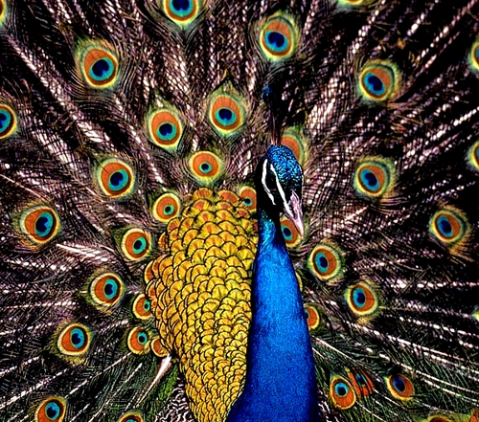
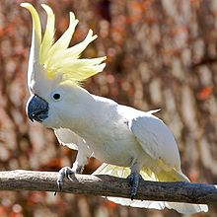
“cockatoos”
“peacocks”
What kind of images are we presented with in the first three stanzas? What do they tell us about the speaker’s past relationships with men?

Slide 11
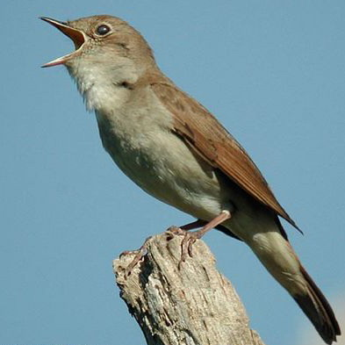
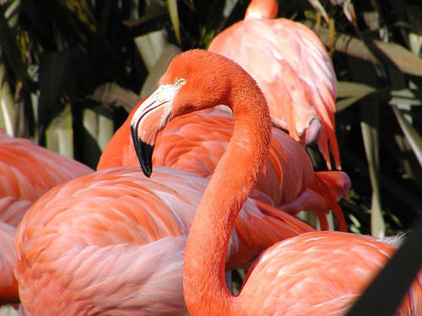
“strutting pink flamingos”
“nightingales”
What kind of images are we presented with in the first three stanzas? What do they tell us about the speaker’s past relationships with men?

Slide 12
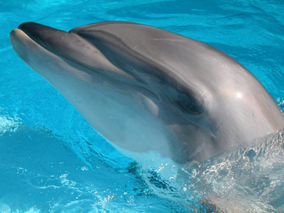
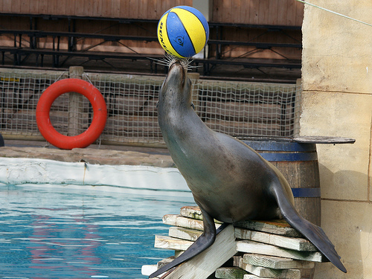
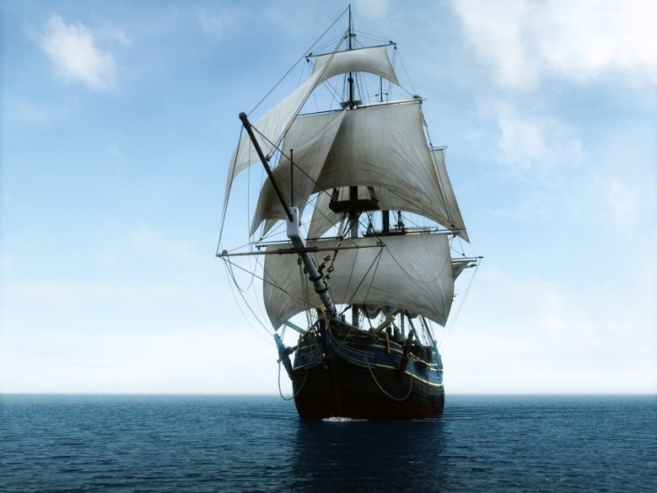
Men were my dolphins, my performing seals; my sailing ships, the ballast in my hold.

Slide 13
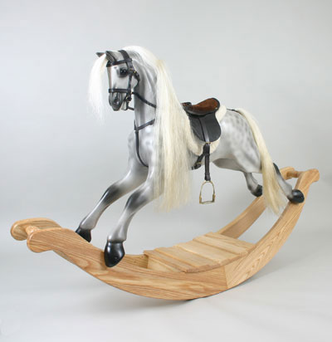
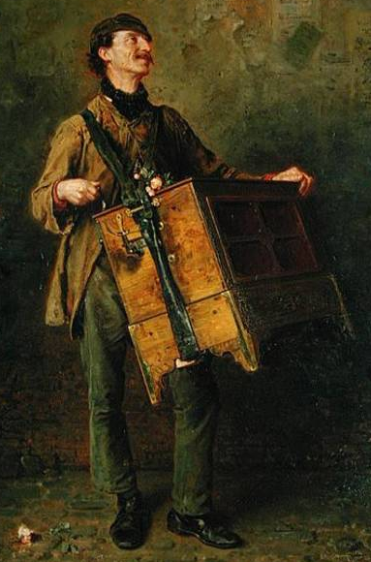
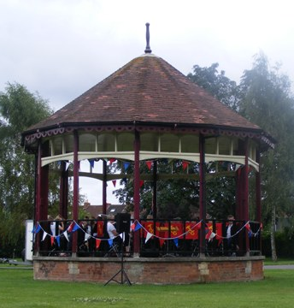
“hurdy-gurdy monkey men”
“rocking horses
prancing”
“the band stand”
What kind of images are we presented with in the first three stanzas? What do they tell us about the speaker’s past relationships with men?

Slide 14
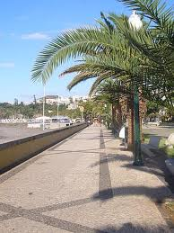
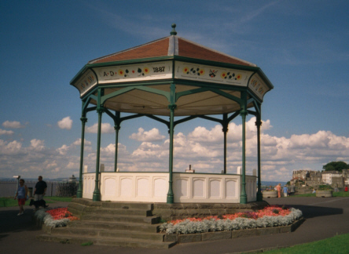
Language cont’d
Promenade-indicates a place specifically intended for walking
Bandstand- circular or semicircular structure set in a park, garden, pier, or indoor space, designed to accommodate musical bands performing concerts

Slide 15
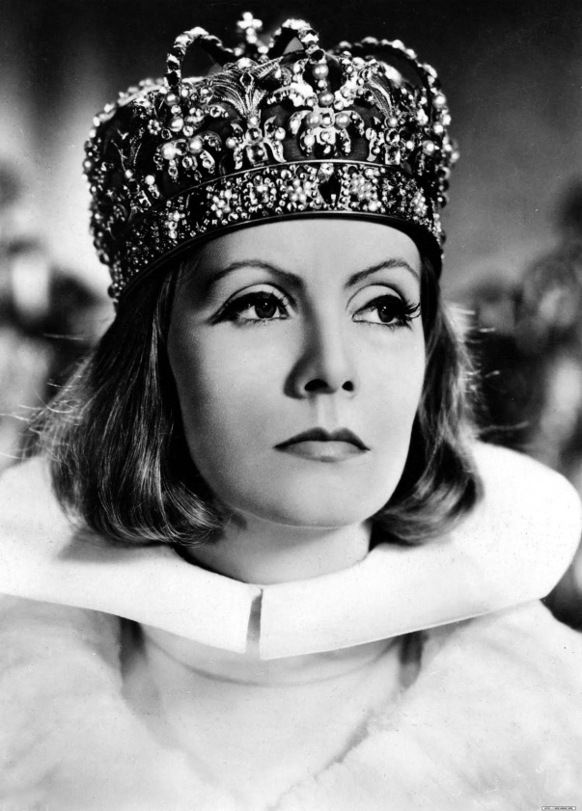
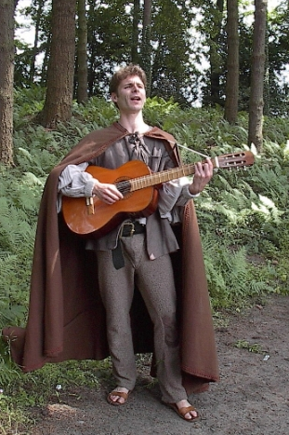
“damsel”
“queen”
“troubadour”
What kind of images are we presented with in the first three stanzas? What do they tell us about the speaker’s past relationships with men?

Slide 16
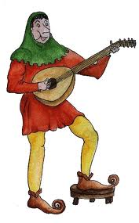
Yet more language
Troubadour-was a composer and performer of Old Occitan lyric poetry during the High Middle Ages
Damsel-The subject of the damsel in distress, or persecuted maiden, is a classic theme in world literature, art, and film. She is usually a beautiful young woman placed in a dire predicament by a villain or monster and who requires a hero to achieve her rescue.

Slide 17
Men were my dolphins, my performing seals; my sailing ships, the ballast in my hold.
What do these images tell us about the speaker’s past relationships with men?
Explode the quote! Come up with as many possible ideas or interpretations as you can. Then write up your ideas in a mini paragraph. Use modal verbs and active verbs for analysing.

Slide 18
NOW THIS TIME:
Men were my buttresses, my castellated towers,
the bowers where I took my rest. The best and worst
of times were men: the peacocks and the cockatoos,
the nightingales, the strutting pink flamingos.
Men were my dolphins, my performing seals; my sailing-ships,
the ballast in my hold. They were the rocking-horses
prancing down the promenade, the bandstand
where the music played. My hurdy-gurdy monkey-men.
I was their queen. I sat enthroned before them,
out of reach. We played at courtly love:
the troubadour, the damsel and the peach.
Ignore the images we’ve just looked at.
Which words are repeated most frequently?
Significance?

Slide 19
But after I was wedded, bedded, I became
(yes, overnight) a toy, a plaything, little woman,
wife, a bit of fluff. My husband clicked
his fingers, called my bluff.
What happens to the speaker after she is married? Pay attention to any techniques (such as metaphors, enjambment, rhyme)?

Slide 20
1. How does the poet present the speaker’s relationship with men before marriage? 2. How does the speaker’s life change after she is married?
Checklist:
Tone of the author
Use of poetic techniques
Changes in structure
Summarise the poem under M.I.T.S.L

