Slide 1
GIVE
Activities: write out 6 words you associate with homeless people.
If you were homeless-what would your banner say??

Slide 2
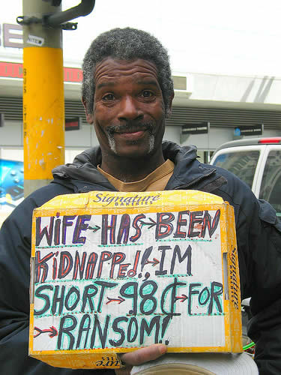
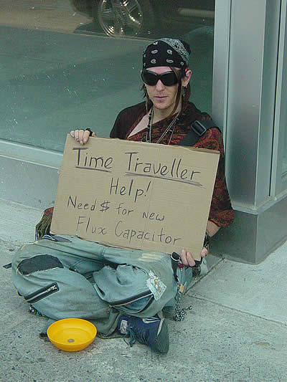
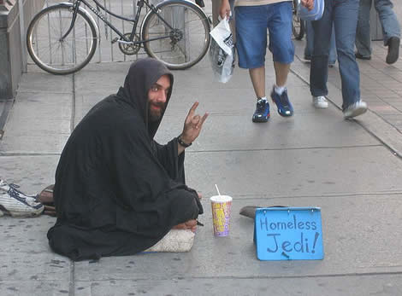
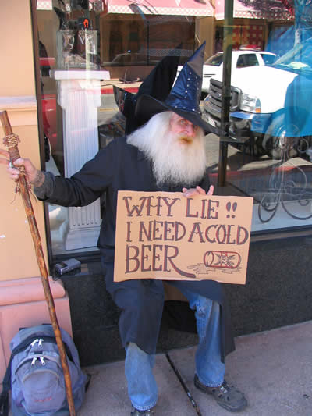

Slide 3
How many of these words correlate with yours??
lazy
dirty
vulnerable
tramps
they only have themselves to blame
unlucky
ostracised
alienated
deserving
uneducated
lonely

Slide 4
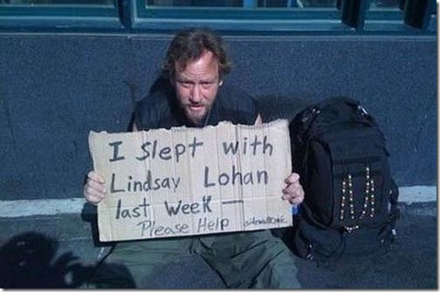
Lesson Objective
LO1: students will be able to critically analyse “Give” using the M.I.T.S.L formula (meaning, imagery, tone, structure, language)
LO2: to develop independent thinking skills when annotating a poem
LO1: students will be able to critically analyse “Give”

Slide 5
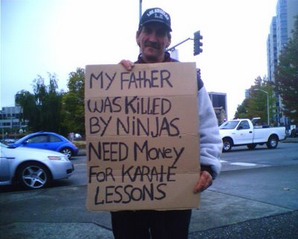
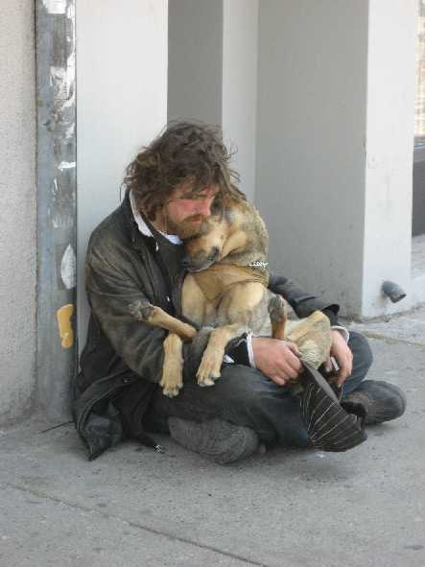
Discuss
What is your opinion of homeless people? Do you think they deserve to be in the position they are in or do you feel sympathy for them?
Why do people usually give money to homeless people? What does it fulfil?

Slide 6
Annotating your poem
Instead of me helping you annotate you are going to take some responsibility yourself at providing annotations.
Why is this useful?
Develop higher order thinking skills
Develop independent thinking
Demonstrate an ability to analyse poetry.

Slide 7
Stanza One
Underline/highlight the word that appears to sound nice and romantic.
What does this word mean in the poem?
Underline/highlight the word that suggests the homeless person has chosen this life.
What does this word suggest to the reader?

Slide 8
Stanza Two
Underline/highlight the same word as stanza one that suggests the homeless person has chosen his life.
What is the effect of repetition?
Underline/highlight the line that implies the reality of homelessness.
Underline/highlight the line that suggests being homeless is free and romantic
What is the effect of contrast between these lines?

Slide 9
Stanza Three
Underline/highlight the words that suggest the importance of money
Underline/highlight the line ‘I can dance or sing’ - what is the voice suggesting here?
Underline/highlight the line ‘swallow swords, eat fire’ – How does this line show his desperation for money?
Underline/highlight the line ‘escape from locks and chains’ – What do these words suggest about he feels about being homeless?

Slide 10
Stanza Four
Underline/highlight the word ‘change’ - What two forms of change could the homeless person want?
Stanza Five
Note down how many sentences are used in the stanza; what is the effect of this?

Slide 11
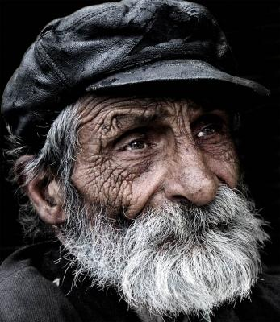
Analysis of the poem
LO1: students will be able to critically analyse “Give”
In his poem “Give,” Simon Armitage takes on the persona of a homeless person who has to resort to begging. It is a deceptively simple twelve-line poem divided into five stanzas. There is a hint of symmetry, but it is a little off balance. Perfect symmetry would not quite suit the theme of the poem.

Slide 12
Of all the public places, dear, to make a scene, I've chosen here.
LO1: students will be able to critically analyse “Give”
“dear.” -someone he used to have a relationship with or sarcasm-knowing that to appear to be linked with a homeless man would cause embarrassment for many?
It is in a “public place”-commentary on how society wants him hidden away from public.
“Of all the places he had to turn up”-repetition of “of all” emphasising the condescending attitude of many in society towards the homeless.

Slide 13
Of all the doorways in the world to choose to sleep, I’ve chosen yours. I'm on the street, under the stars.
“Of all” repetition
“I’ve chosen”-is this the lifestyle choice the homeless man wants to make? Repetition of choice and choosing reinforces the notion of a lack of choice for many homeless today
Rather than a full rhyme as in the first stanza, “yours” and “stars” at the end of lines 4 and 5 create a half rhyme. Couple this with the enjambment and there is a continuing sense of a disjointed world

Slide 14
For coppers I can dance or sing. For silver - swallow swords, eat fire. For gold - escape from locks and chains
Coppers-more than one meaning-homeless being continually moved on by police-made to “dance or sing” at their behest.
For silver-swallow swords/eat fire-for a sick homeless man eating causes physical pain-what is the effect of this alliteration?
Locks and chains- a life of imprisonment despite previous romanticism of being “under the stars”

Slide 15
It's not as if I'm holding out for frankincense or myrrh, just change.
The speaker takes on a defensive, trying to show that he isn't asking for huge rewards or donations. He does this by referring to the gifts the three kings offered at the time of the birth of Jesus. He did mention gold in the previous stanza, which was one of those gifts, but here he says he is not asking for “frankincense or myrrh.” Armitage uses the pattern of the first and second stanzas again here, with enjambment linking line 9 to line 10. The stanza ends with the phrase “just change,” indicating that all the homeless person is asking for is a few coins.
Change-how many meanings does this have?
Loose change
Change in way of life
Change in attitude

Slide 16
You give me tea. That's big of you. I'm on my knees. I beg of you.
The final stanza consists of four short, simple sentences within two lines which emphasises the abject misery and desperation of the poet. The sardonic phrase “You give me tea. That's big of you.” gives a clear indication of the speakers frustration at what people feel is enough help.
“I'm on my knees” conveys a sense that the homeless person is desperate, but perhaps also that he is asking forgiveness for something he did in the past. Contrast being on knees with a cup of tea. The phrase “im on my knees” has much more serious connotations.
“I beg of you.” reminding the reader at the last that this mans life depends on how people respond to his begging.

Slide 17
In “Give” Simon Armitage has used pattern, half-rhyme, repetition and enjambment to create a wonderfully effective poem. His use of alliteration builds up and intensifies the ideas he presents. Although this could illustrate the plight of any beggar or homeless person, the speaker has deliberately chosen certain places that have a strong link to the person he is talking to. Everything points to the feeling that he was previously in a relationship with the person whose doorway he now sleeps in. He is asking the person to give, but also to forgive him.

Slide 18
Tone
Is his use of the word “dear” sincere??
What about “that’s big of you”??
Sarcastic tone-underline the phrases or words you think might be sarcastic....
Can you think of other examples where you say one word and it means the opposite

Slide 19
Tone continued
Think of two guys squaring up to each other
Listen here mate
I'm not your mate buddy
What about that last piece of work you handed in?
“oh really really great work, how did english ever progress as a language without you?”

Slide 20
Form
This poem is a dramatic monologue. A dramatic monologue is a piece of verse that gives the speaker a voice to EXPRESS his / her feelings to a silent audience.
In the case of ‘Give’, Simon Armitage is giving a voice to homeless people who are often ‘voiceless’. In this poem, the beggar expresses his / her bitter feelings about being on the street and being neglected. He is desperate and perhaps bitter about his situation; this is expressed through his TONE and SARCASM.

Slide 21
Give
Of all the public places, dear, to make a scene, I've chosen here.
Of all the doorways in the world to choose to sleep, I’ve chosen yours. I'm on the street, under the stars.
For coppers I can dance or sing. For silver - swallow swords, eat fire. For gold - escape from locks and chains.
It's not as if I'm holding out for frankincense or myrrh, just change.
You give me tea. That's big of you. I'm on my knees. I beg of you.
Simon Armitage
Notes:
Armitage presents a scathing attack on society’s view of the homeless through this dramatic monologue. The carefully chosen sarcastic phrases and repetition of “Of all”

