Slide 1
Checking Out Me History
John Agard

Slide 2
What is your idea of history?
What is your idea of history?

Slide 3
Coady - Dweller at a Wood [Cornish coid, coat = Welsh coed = Breton coad, coat]
Pollard - It is thought that this name was most commonly given to people who had closely cut hair as the name comes from the Middle English word ‘poll’ which means the head. However, the name could have also come from the medieval name Polhard, which derives from the name Paul.
Gell - Jewish (eastern Ashkenazic): nickname for a man with red hair, from Yiddish gel ‘red-headed’, Middle High German gel ‘yellow’, German gelb (see Geller).
German: unexplained.
English: from a short form of the personal name Julian.
Variant of French Gille.
Battle - English and Scottish and Irish (of Norman origin): habitational name from a place named as having been the site of a battle, from Old French bataille ‘battle’. In some cases, this may be Battle in Sussex, site of the Battle of Hastings
McAlpin - Scottish and northern Irish: Anglicized form of Gaelic Mac Ailpein (Scottish), Mac Ailpín (Irish) ‘son of Ailpean’, a personal name of uncertain etymology, possibly derived from alp ‘lump’. The personal name was borne by Pictish kings, one of whom, Kenneth, son of Ailpín, Ailpean, became the ruler of the united Picts and Scots and is regarded as the founder of the somewhat disparate clan of this name.
Dada - Muslim: from a personal name based on the Persian dāda ‘given’ (i.e. ‘gift of God’).
Indian (Maharashtra): Hindu and Muslim name meaning ‘elder brother’ in Marathi, also used as an honorific term of address.

Slide 4
What is the poem about?
http://www.bbc.co.uk/learningzone/clips/john-agard-checking-out-me-history-poem-only/12247.html
This poem makes the reader question the way in which history is taught and how we, the reader, conceive our own identity as we learn about other cultures and races other than our own, as he uses the poem to express his discontent about the way he was taught history.
As the poem progresses, it becomes evident that Agard has been forced to follow a British curriculum biased towards whites in particular, British whites – meaning that he has been forced to learn about mythological and nursery rhyme characters rather than living black people from the past.
He challenges this view of history and cites some major black figures to balance the bias and create a basis for his own identity.

Slide 5
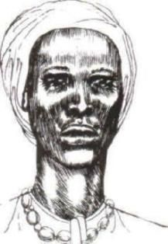
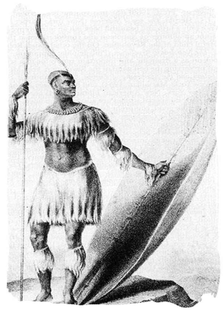
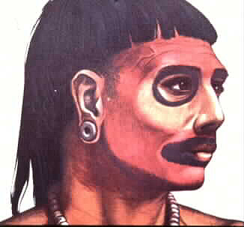
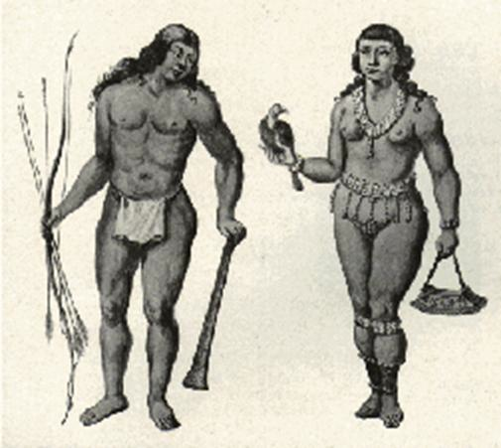
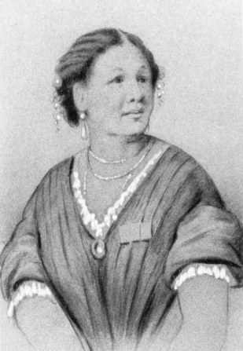
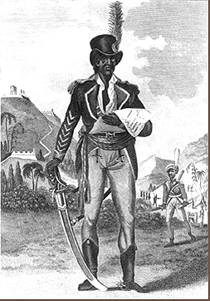
Who are the people that he wants to learn about?
Nanny de Maroon – leader of Maroons who led Jamaican resistance against the British
Lord Nelson – officer in the Royal Navy who died during the Battle of Trafalgar
Caribs and Arawaks – Caribbean people whose island were invaded by Europeans
Shaka – influential Zulu leader and warrior
Toussaint L’Ouverture – ruler who led slaves to victory in the Haitian revolution
Mary Seacole – Jamaican nurse who helped to heal the sick in the Crimean War

Slide 6
Dem tell me
Dem tell me
Wha dem want to tell me
Rhythmic in repetition . The short lines call attention immediately in accusatory tone.
Caribbean Creole used. Links narrator’s voice to his identity.
Emphasising separateness of the British Education system from himself
Accusatory Tone - the tone in which the narrator uses suggests blame or criticism towards what history he was taught and those he was taught by.

Slide 7
Bandage up me eye with me own history
Blind me to me own identity
Accusatory tone gains intensity with longer , rhythmic lines.
Metaphor used for not allowing him to see his own history – sense of self.
The repeated phrasing shows that personal identity and history/heritage are connected.
Dismisses British History – assumes that the reader knows it
Dem tell me bout 1066 and all dat
dem tell me bout Dick Whittington and he cat
But Toussaint L’Ouverture
no dem never tell me bout dat
Dick Whittington is a pantomime character this suggests that he is mocking British history calling it ‘trivial’ if we learn about fictional characters.

Slide 8
The pace of the piece slows down here and this suggests that he is deviating away from the subject to recall this memory.
Toussaint
a slave
with vision
lick back
Napoleon
battalion
and first Black
Republic born
Toussaint de thorn
to the French
Toussaint de beacon
of de Haitian Revolution
This creates imagery of light and vision which represent knowledge contrast to his blindness to his own history
Strong rhyme and broken syntax show the importance of oral contact
Story of Toussaint makes the piece sound like a chant – chant suggests more than one voice - it is oratory and plural.

Slide 9
Once again the narrator makes an example of the absurd history he is being taught explaining that he is being taught a nursery rhyme instead of real, factual history
Dem tell me bout de man who discover de balloon
and de cow who jump over de moon
Dem tell me bout de dish run away with de spoon
but dem never tell me bout Nanny de maroon
Simple rhyme emphasising the triviality of the British history that he is being taught. The rhyme builds up the final line where we learn what he really wants to learn about.

Slide 10
Linked to vision and light – she can see a future for everyone.
Nanny
See-far woman
of mountain dream
fire-woman struggle
hopeful stream
to freedom river
Represents Nanny as a spiritual character by connecting her with dreaming, streams and rivers. The narrator also links her with hope and liberty so this gives him hope that he will find out the truth about his own history.
Suggests she is a passionate woman but also brings warmth and light to the narrator even in times of darkness.
This, like the ‘Toussaint story’ has plural lines and an oratory quality but this story is told in fragments and is not linear and complete in the way it sounds. It also befits the story of a “see-far” woman, a visionary woman? The fragmentation creates a mystery, a puzzle, and asks you the listener to see in another dimension, and to recognize an unconventional heroine—not a fairy tale, but a more believable tale of a woman with supernatural powers perhaps. This may suggest a specific addressee as well.

Slide 11
Dem tell me bout Lord Nelson and Waterloo
but dem never tell me bout Shaka de great Zulu
Dem tell me bout Columbus and 1942
but what happen to de Caribs and the Arawaks too
The European Coloniser (Columbus) is compared to the native American cultures (Caribs and Arawarks) that resisted slavery – there is a contrast between the restriction of the native American’s and the freedom that Columbus had to explore.
Makes her seem unimportant and basic despite her being one of the most important pioneers of medicine that this country has ever seen – linked to nursery rhyme characters in the stanza by undermining her.
Contrast between the fictional British heroin and legend Robin Hood and the important real life figure Mary Seacole.
Dem tell me bout Florence Nightingale and she lamp
and how Robin Hood used to camp
Dem tell me bout ole King Cole was a merry ole soul
but dem never tell me bout Mary Seacole

Slide 12
From Jamaica
she travel far
to the Crimean War
she volunteer to go
and even when de British said no
she still brave the Russian snow
a healing star
among the wounded
a yellow sunrise
to the dying
Earlier on in the poem, Agard uses a line from a nursery rhyme (and the cow jumped over the moon) as an example of British history – for Jamaican history he uses an inspirational woman and this once again highlights his view that British history is meager compared to Mary Seacole.
Suggests that she is defiant and strong.
This imagery links her to the wider universe as images of light, hope and prosperity are presented to the reader.
The hard-hitting (sounding) “go,” “no,” and “snow,” grab the reader’s attention to the speaker’s crescendo moment in the poem. It is a noticeably loud moment particularly because the woman’s defiance is immediately followed by the speaker’s concluding defiance.

Slide 13
The speaker tells us the reason for the address—that he has reclaimed his power, that he can see for himself now. The poem ends on a triumphant note in that sense. The triumph is anti-climactic of course (although complete in a poetic sense) since we are long aware before the end that he has checked out his own history.
Repetition of the phonetic lines of the first stanza re-iterating the anger of the narrator about his predicament.
Dem tell me
Dem tell me wha dem want to tell me
But now I checking out me own history
I carving out me identity
Positive and triumphant as he is taking charge of his own identity instead of letting others shape it for him.
Suggests that he is going to create a permanent identity for himself instead of his current false one.
Emphatic final word - sums up the main theme of the poem which is to carve out an identity for himself by finding out about his own history instead of a history which is foreign to hm.

Slide 14
Structure of the poem
This poem is in the structure of a dramatic monologue so it is told through only one speaker – the narrator and this makes the poem more personal.
As the poem progresses, so does the narrator’s anger and this is clearly shown as his disrespect for British History is evident as he even ‘down plays’ Florence Nightingale’s achievements to ‘all dat’. He also highlights the triumph of Jamaican heroin's and figures. We are also told ‘mini-stories’ and with these the length of the stanza increases
From the first line we can sense a tone of discontent and the first stanza tells of his concern – we can also tell that he is foreign through the use of Jamaican Creon – the poet repeats the line ‘dem tell me’ for added emphasis on the fact that this is being forced on him and not personal choice.
At the end of the poem the poet repeats the first 2 lines of the first stanza and this adds effect as this is a reflection because history is all about reflecting and learning and we are told that he is going to carve out his own identity and this shows that he has succeeded in his aim to learn about his history because in order to carve an identity you have to have a knowledge of your history.

Slide 15
Language of the poem & key terms
Key terms
Dramatic Monologue
Colloquial
Dialect – Jamaican Creon used
First person
Rhythmic
Syntax
Theme
Throughout the whole of the poem the narrator uses Jamaican Creon rather than British English and this highlights the fact that he is foreign and not originally from Britain and this idea is key to the message that he wants to convey to the reader that the way history is taught instead of ‘blinding’ people from their own history.
Through writing this in the first person, personal language is used and the narrator can express his feelings stronger than if the poem was wrote in the third person, then the narrator’s discontent would not be as widely regarded by the reader
Colloquial language is used in this poem as the poem, when read, sounds like everyday spoken language, because he uses words such as ‘dem’ instead of them and ‘me’ instead of my.

Slide 16
Has your idea of the teaching of history changed after reading the poem or do you think that this is just one man’s view and no change is needed?

